Slide 1
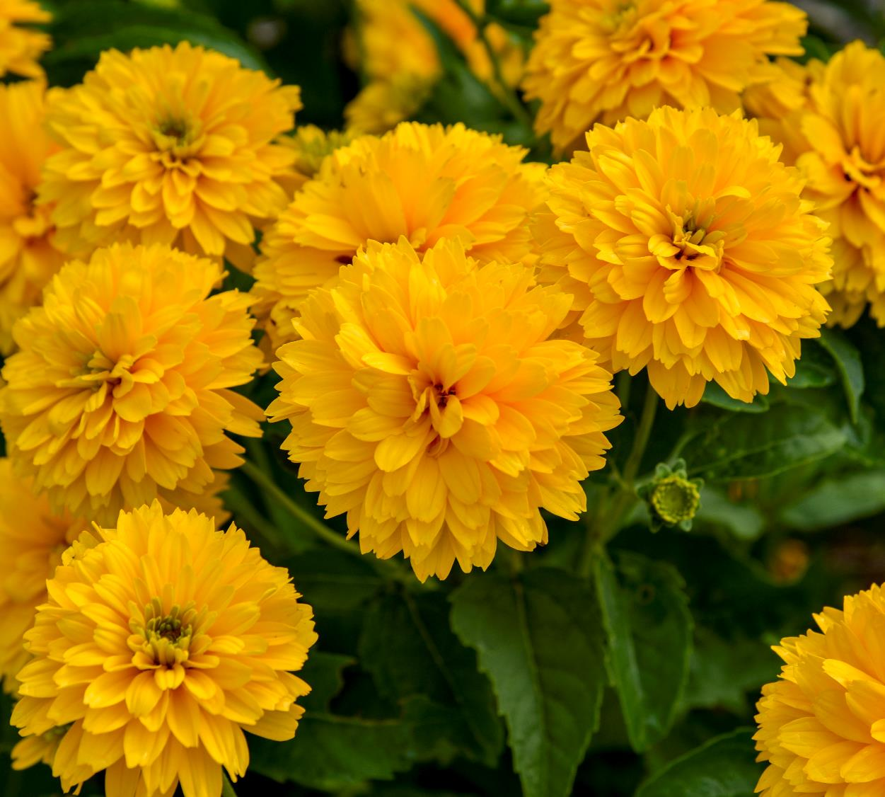
New Plant Intros
2025-2026 SEASON

Slide 2

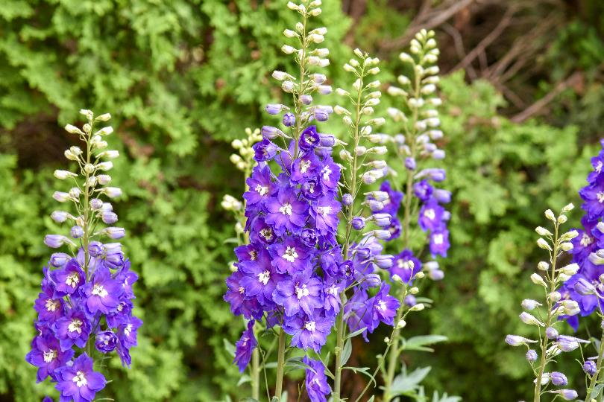
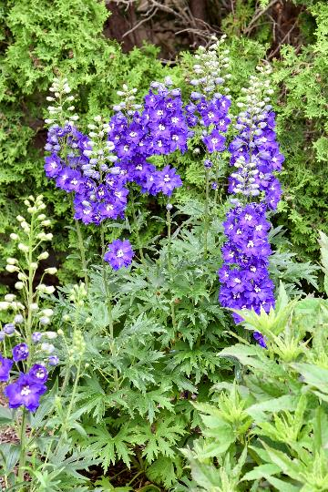
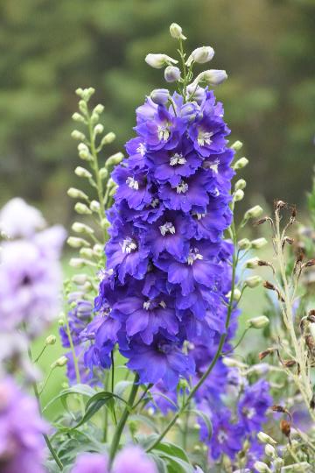











‘Violets are Blue’
Delphinium PPAF CPBRAF
Hybrid Bee Delphinium | Height: 30-36” | Width: 18-24” | Zones: 3-7
Flowers are a blend of blue and purple with white bees
Intermediate in height on sturdy stems
From Tissue Culture for uniformity​

Slide 3
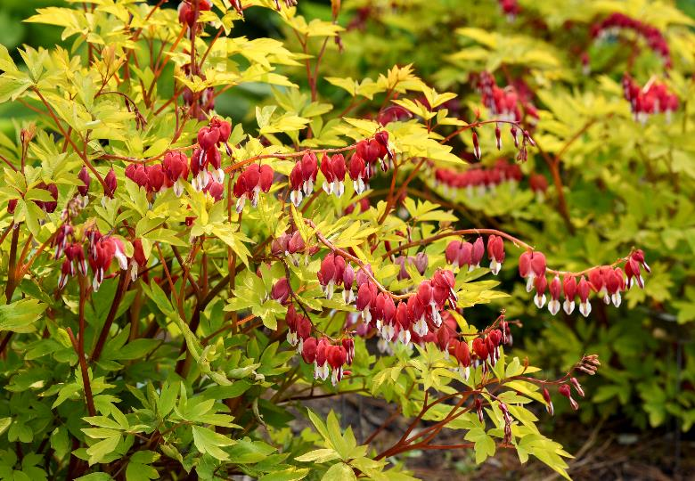
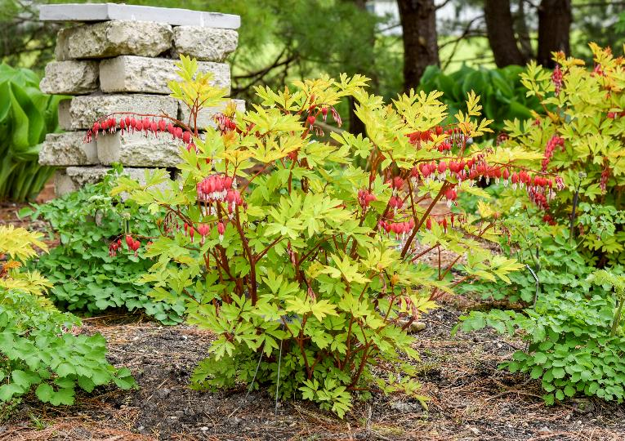





‘Hearts on Fire’
Dicentra spectabilis PPAF CPBRAF
Old Fashioned Bleeding Heart | Height: 18-24” | Width: 24-36” | Zones: 3-9
Golden leaves with bronze highlights and dark stems create a vibrant contrast.
True red flowers emerge in late spring
Long scapes flower for an extended period, with flowers showing outside the foliage to maximize display

Slide 4
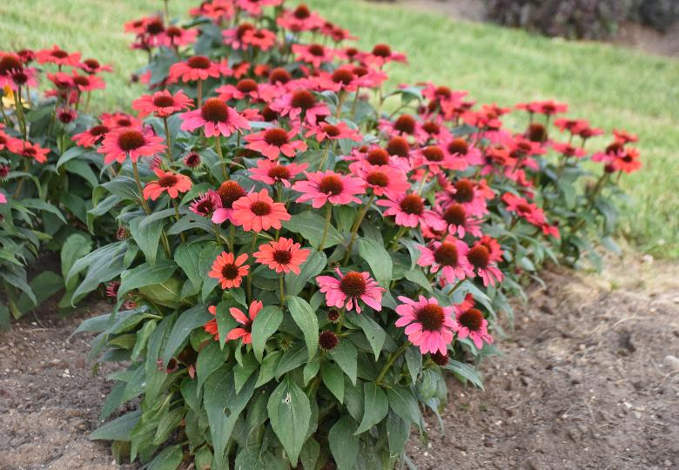
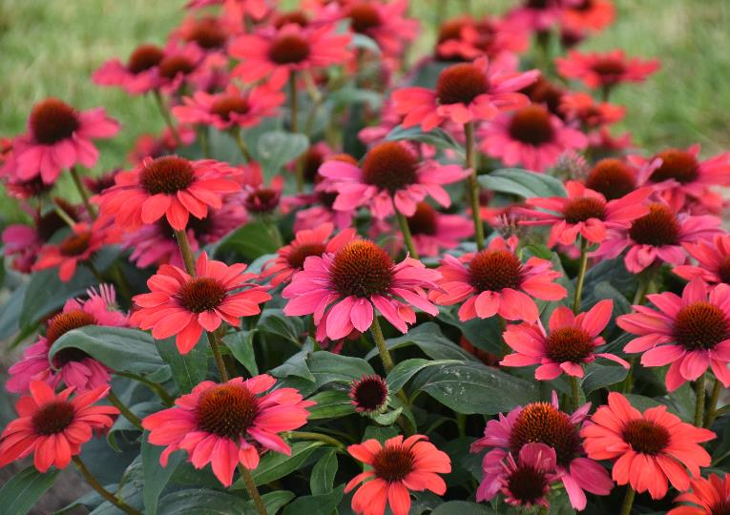


COLOR CODED® ‘Knock ‘em Red’
Echinacea PPAF CPBRAF
Coneflower | Height: 20-24” | Width: 16-20” | Zones: 4-8
4” wide fluorescent red flowers open crimson and mature to mauve
Excellent basal branching
Dark green leaves

Slide 5
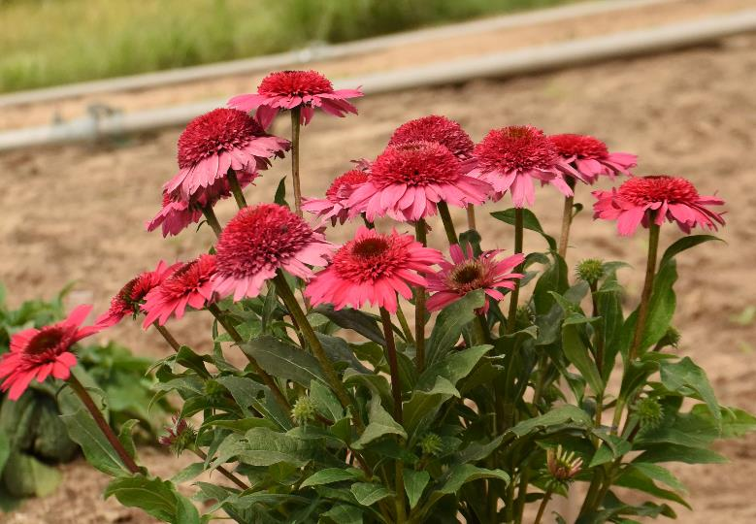
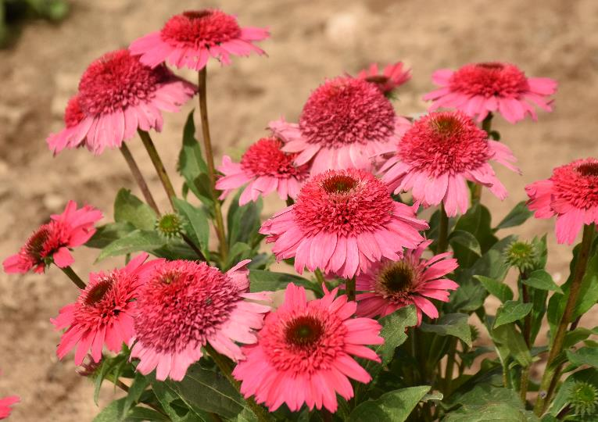
DOUBLE CODED® ‘Coral Cranberry’
Echinacea PPAF CPBRAF
Coneflower | Height: 18-20” | Width: 16-20” | Zones: 4-8
Bright coral pink flowers with wide horizontal ray petals
Excellent basal branching

Slide 6
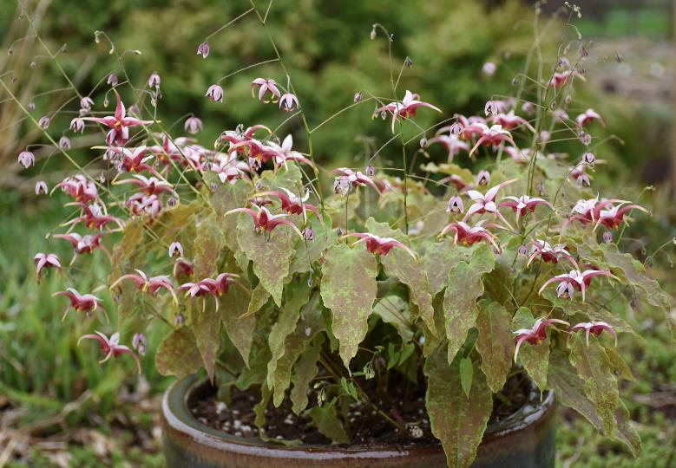
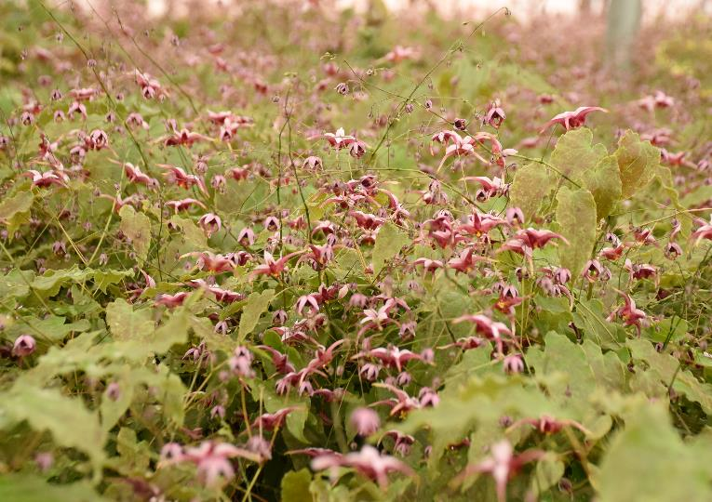

‘Hugs and Kisses’
Epimedium PPAF CPBRAF
Barrenwort | Height: 8-12” | Width: 18-24” | Zones: 5-8
Leaves are lightly mottled with burgundy red over its green leaf color base​. Slight wavy leaf margins​
Bicolor flowers – backs of flowers are light pink with the centers a deep mauve​
Selections for Proven Winners have long inflorescences of large flowers, producing blooms for many weeks in spring.

Slide 7
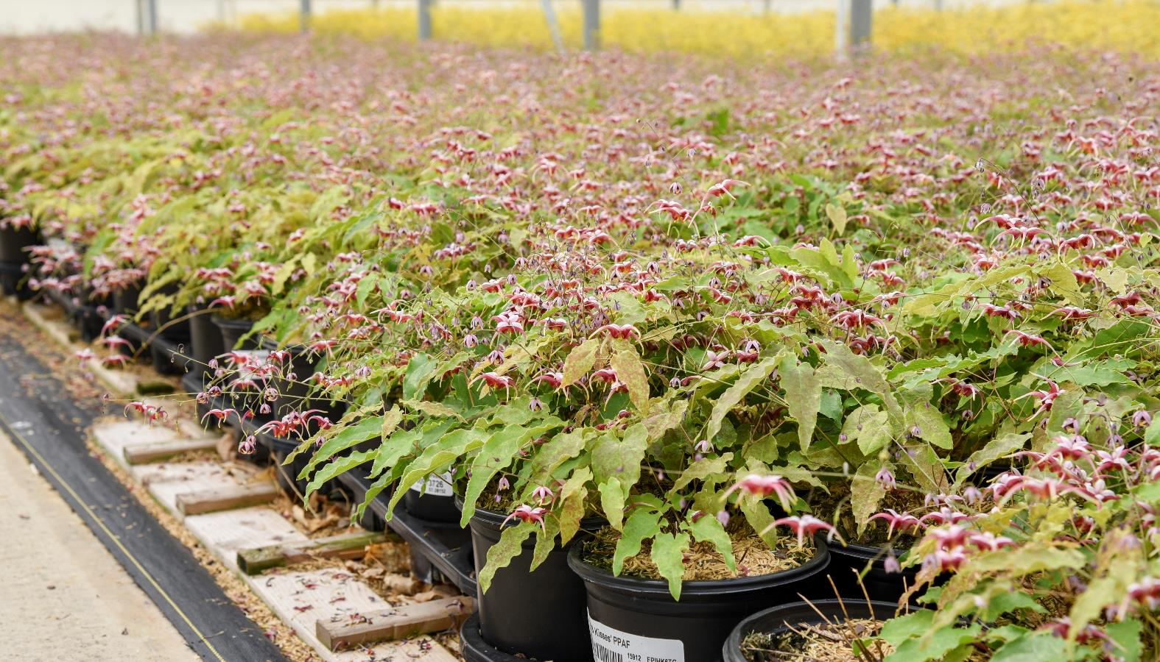
Epimedium ‘Hugs and Kisses’
Greenhouse Stock Container Production

Slide 8
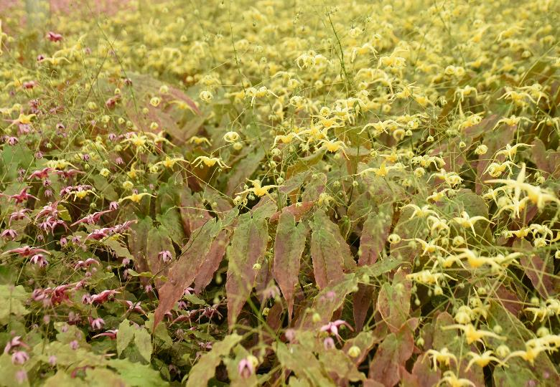
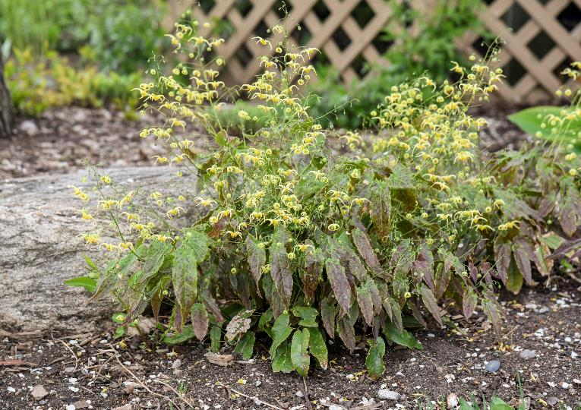
‘Woodland Elf’
Epimedium PPAF CPBRAF
Barrenwort | Height: 18” | Width: 18-24” | Zones: 5-8
Green, lance-shaped foliage with some burgundy bronze speckling. Especially notable on lower leaves​
Yellow flowers​
Selections for Proven Winners have long inflorescences of large flowers, producing blooms for many weeks in spring.

Slide 9
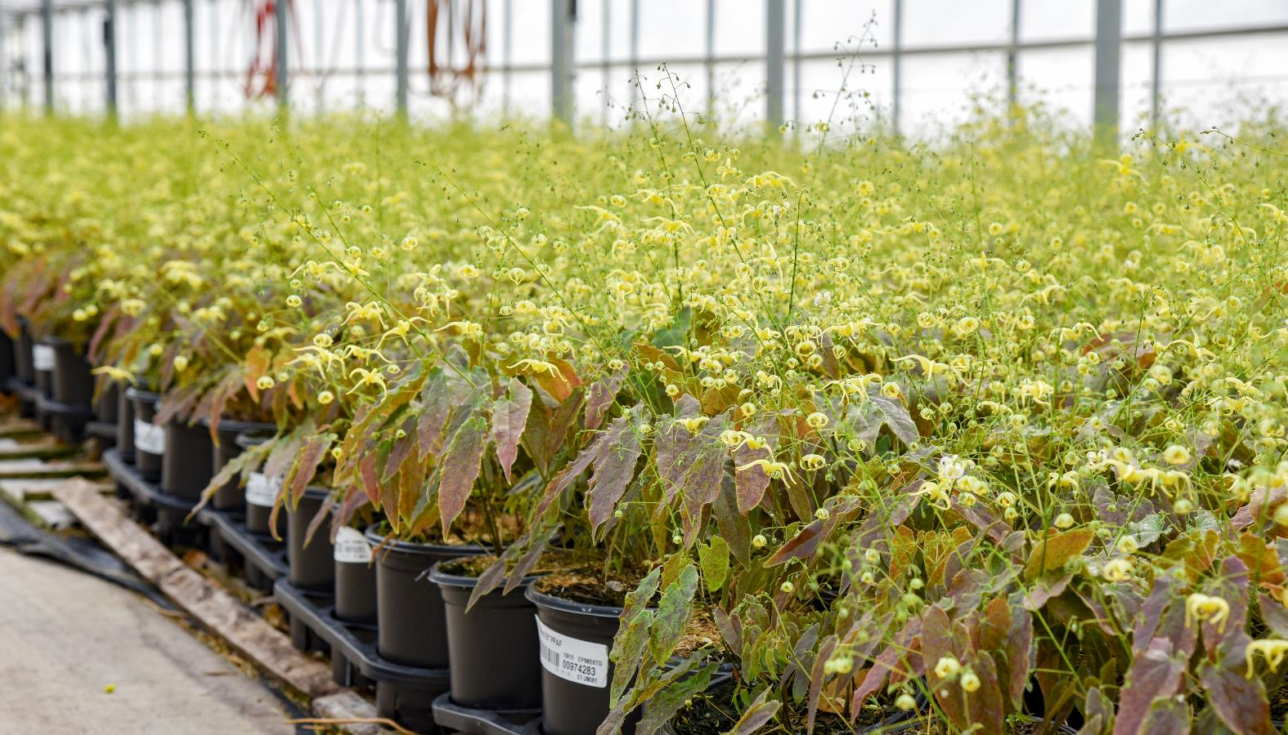
Epimedium ‘Woodland Elf’
Greenhouse Stock Container Production

Slide 10
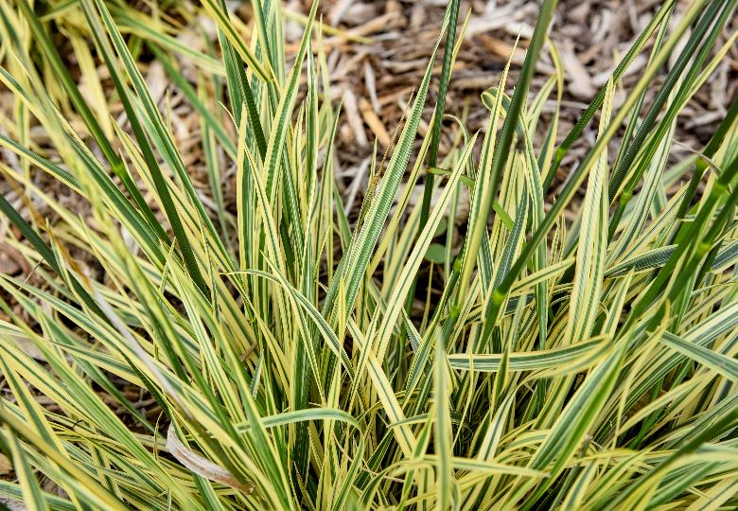
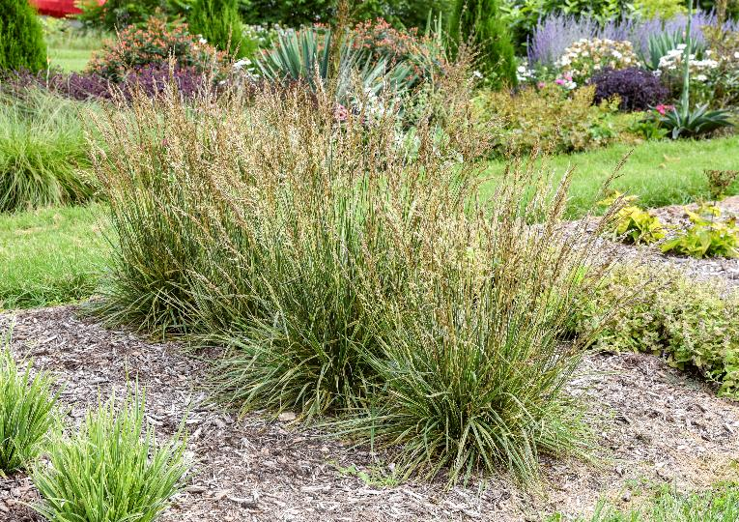

‘Perfect Edging’
Festuca arundinacea PPAF CPBRAF
Tall Fescue | Height: 14-18” | Scape Height: 30-34” | Width: 18-24” | Zones: 3-7
Variegated foliage, with creamy white margins surrounding blue-green leaves.
Variegation is most pronounced as the plant emerges in early spring, and will later match the lightly colored seedheads.
Flowers appear in early summer, remaining upright through the end of the season

Slide 11
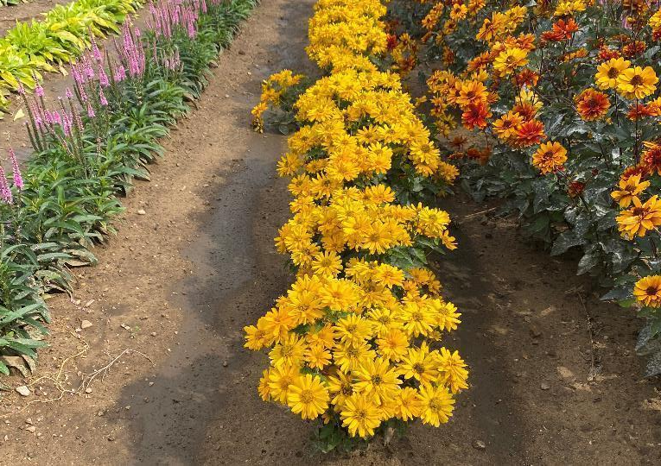
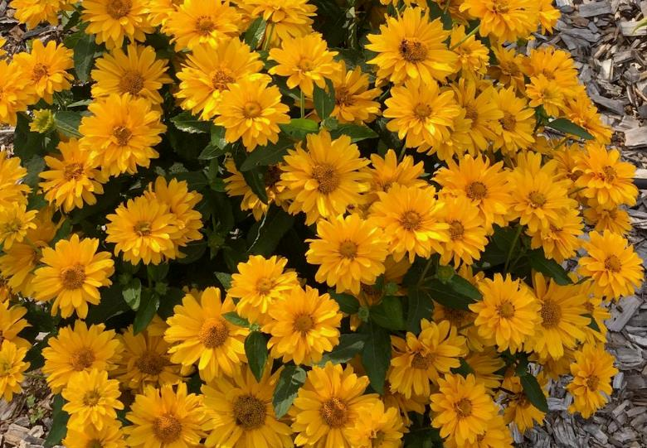
Athena Gold™
Heliopsis helianthoides
False Sunflower | Height: 18-24” | Width: 16-20” | Zones: 3-9
A very compact False Sunflower with sunny yellow flowers.
Each flower is packed with petals, extending the life of individual blooms.
An excellent choice to keep pollinators happy and add color to the middle or front of the border.

Slide 12
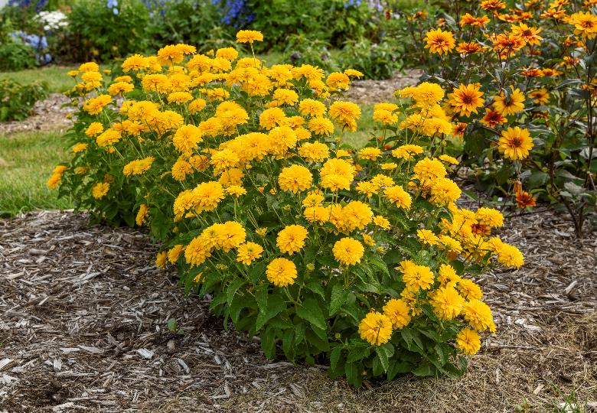
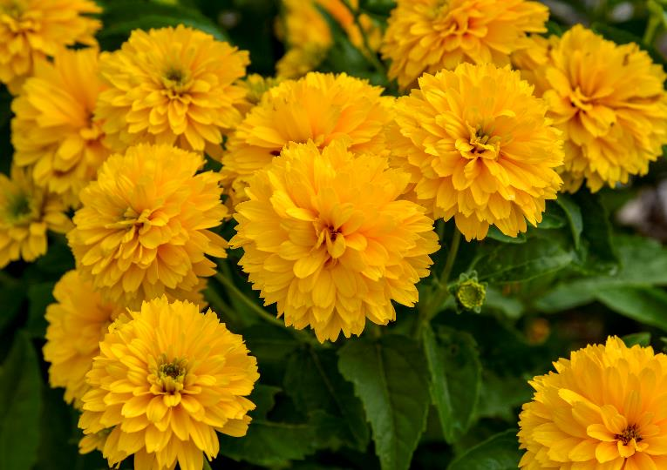
‘Rays for Days’
Heliopsis helianthoides PPAF CPBRAF
False Sunflower | Height: 24-26” | Width: 18-20” | Zones: 3-9
Fully double golden yellow flowers – our most floriferous selection to date!
Upright, mounding habit​ has excellent mildew resistance
Tall stems and a Zinnia-like appearance make them a perfect cut flower selection

Slide 13
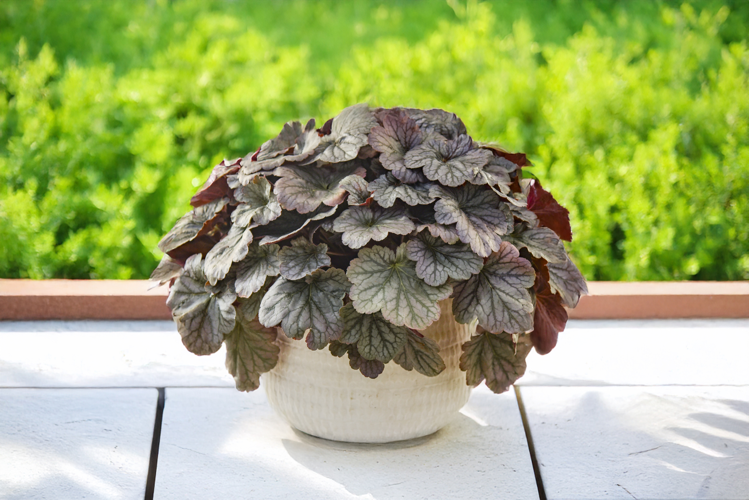
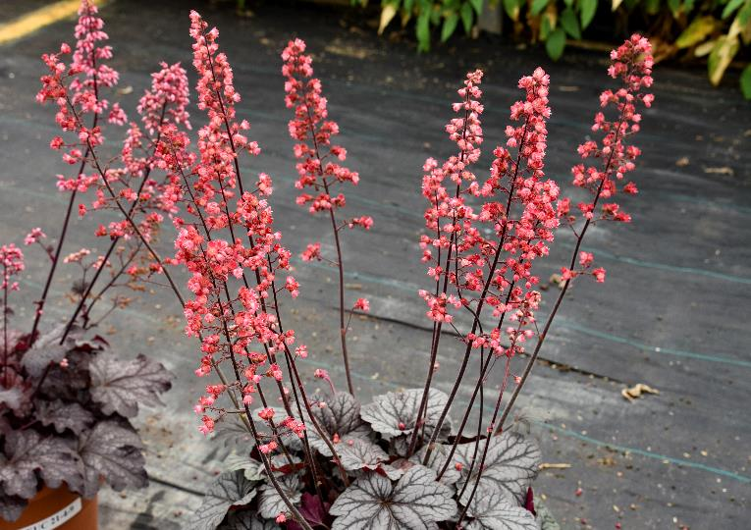
DOLCE® ‘Glazed and Infused’
Heuchera PPAF CPBRAF
Coral Bells | Height: 8-10” | Scape: 22-24” | Width: 12-14” | Zones: 4-9
Large silver leaves with charcoal-black veins and gentle ruffling form a dense, mounding habit
Upright scapes of deep rose-pink flowers appear in early summer, blooming without vernalization
Taller and more mounding than 'Silver Gumdrop'

Slide 14
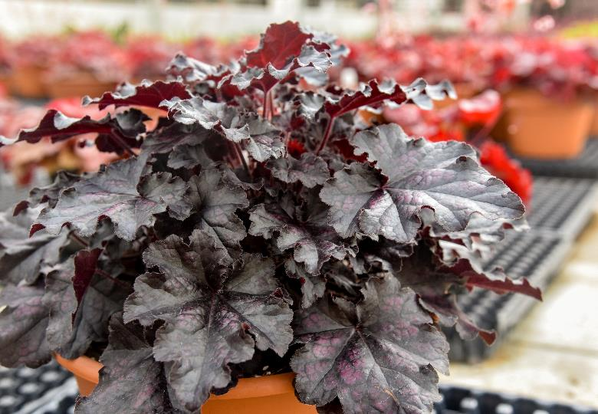
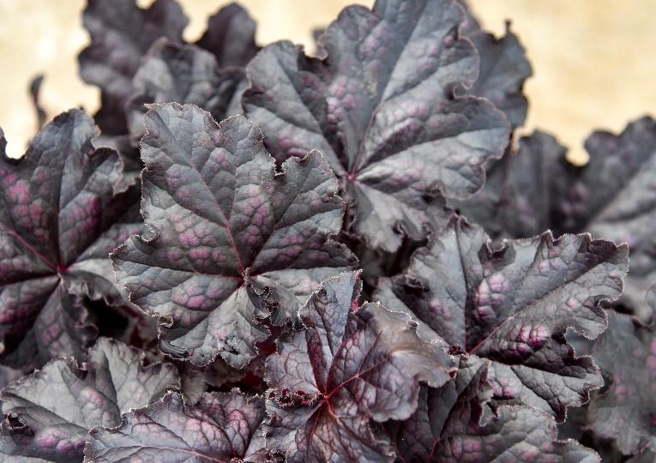
DOLCE® ‘Sultry Night’
Heuchera PPAF CPBRAF
Coral Bells | Height: 8-10” | Width: 16-20” | Zones: 4-9
Ruffled black leaves have purple overlay – purple highlights match the color of leaf undersides and stems
Short petioles create a compact, dense habit

Slide 15
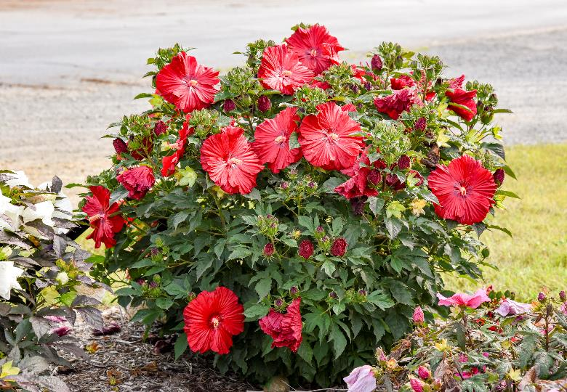
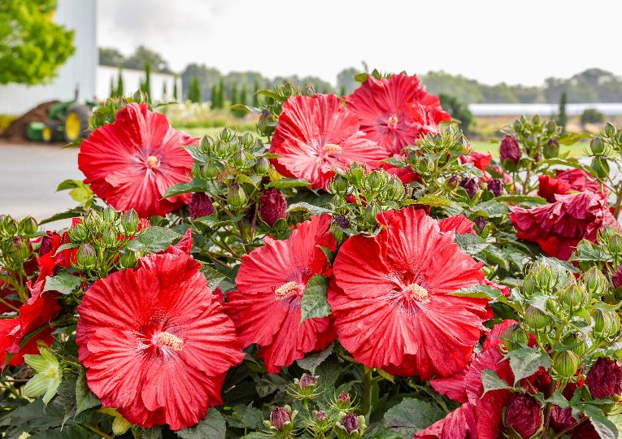

SUMMERIFIC® ‘Garnet Globes’
Hibiscus PPAF CPBRAF
Rose Mallow | Height: 36-42” | Width: 36” | Zones: 4-9
Tons of buds, opening to 7” wide dark magenta red flowers​
Compact, upright habit, dark green foliage​
Compared with ‘Valentine’s Crush’, ‘Garnet Globes’ is a deeper shade and about half the size.​

Slide 16
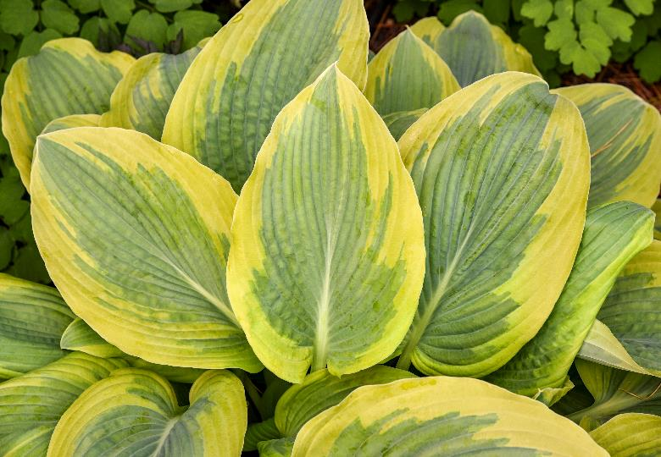
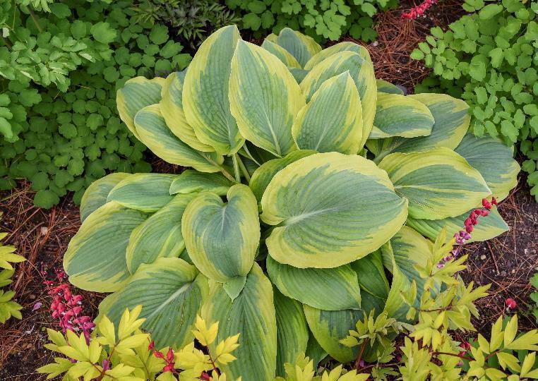
SHADOWLAND® ‘Chance Encounter’
Hosta PP36151 CPBRAF
Hosta | Height: 13” | Scape: 16” | Width: 32-34” | Zones: 3-9
Heart shaped powdery blue leaves with a jagged chartreuse margin. There is a watermark halo where the center and margin meet​
Clean gold margin, emerges apple green​
Heart shaped leaves, flat habit (wide)​

Slide 17
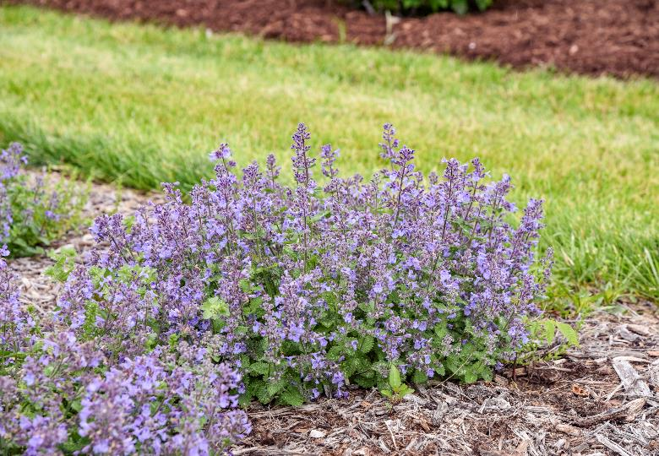
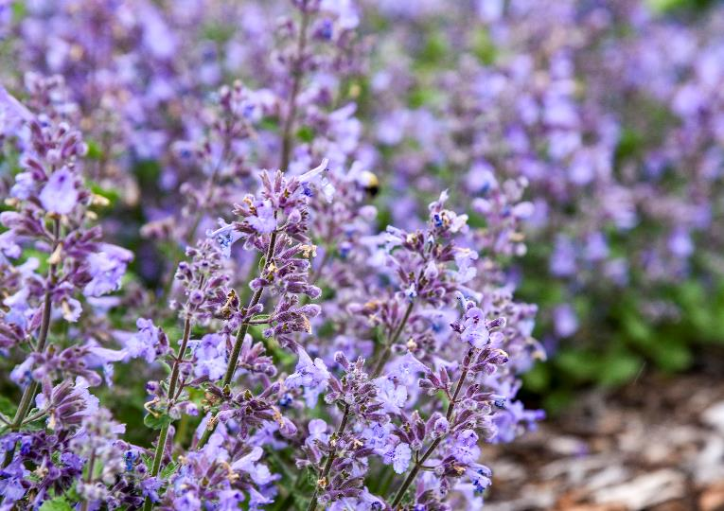
‘Catwalk Queen’
Nepeta PPAF CPBRAF
Catmint | Height: 10-12” | Width: 18-20” | Zones: 3-8
Compact, dense Nepeta
Large flowers – twice the size of normal Catmint flowers – and very long panicles
Very thick leaves

Slide 18
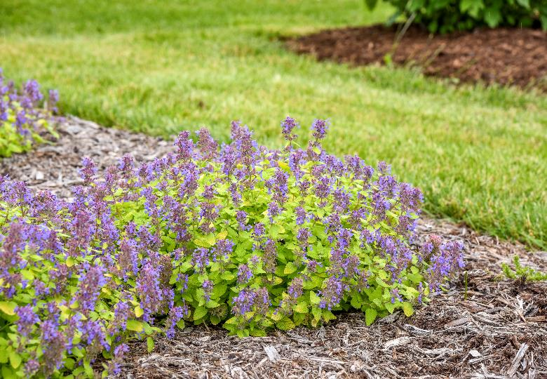
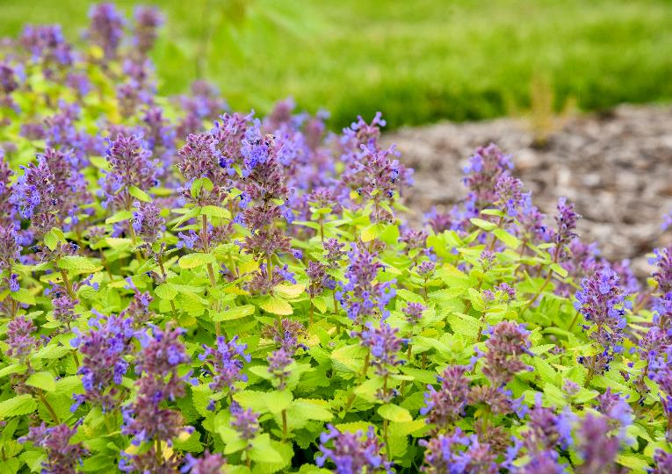
‘Lemon Purrfection’
Nepeta PPAF CPBRAF
Catmint | Height: 10-12” | Width: 16-18” | Zones: 3-8
Very polished, compact horizontal habit of gold foliage with lavender blue flowers​ on reddish purple calyxes
With increased shade cover the leaf color will be more chartreuse.
Early to flower. This selection blooms continuously without being cut back.

Slide 19
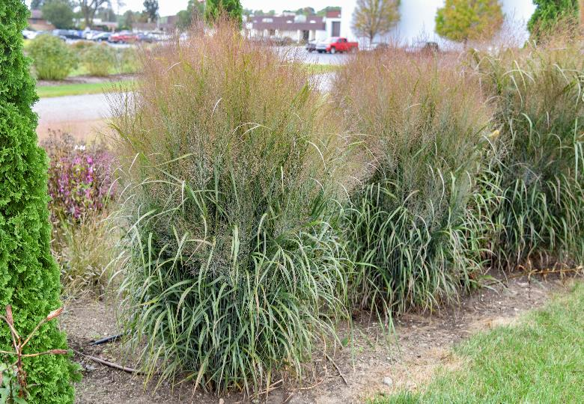
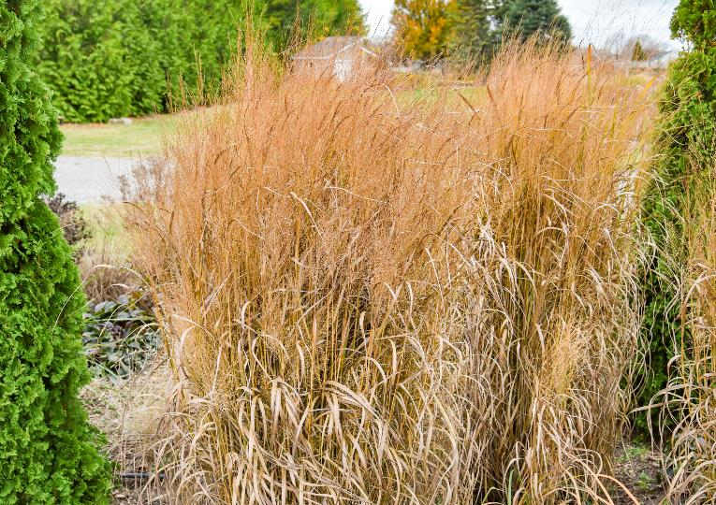
PRAIRIE WINDS® ‘October Sky’
Panicum virgatum PPAF CPBRAF
Switch Grass | Height: 5’ | Width: 2½’ | Zones: 4-9
Blue green foliage is covered with rosy purple seedheads in late summer.
Compared with ‘Apache Rose’, ‘October Sky’ is taller, has darker colored seedheads

Slide 20
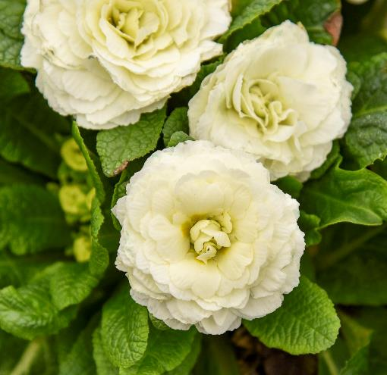
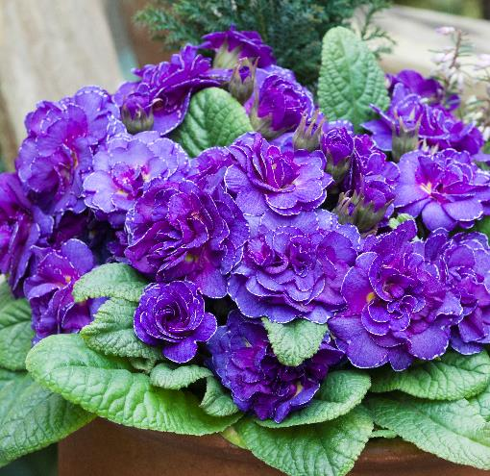
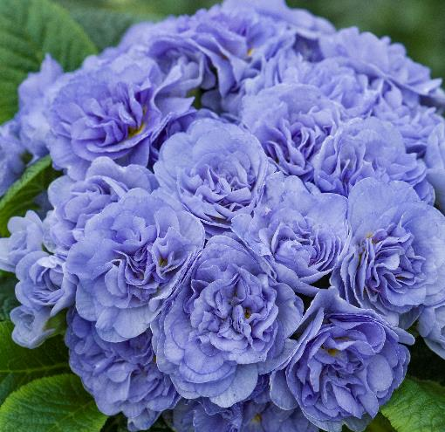
Primula vulgaris BOUQUET PERFECT™ Series
Primrose | Height: 5-8” | Width: 10-12” | Zones: 4-8
Large, clean flowers
Sterile flowers result in plants that are particularly long blooming

Slide 21
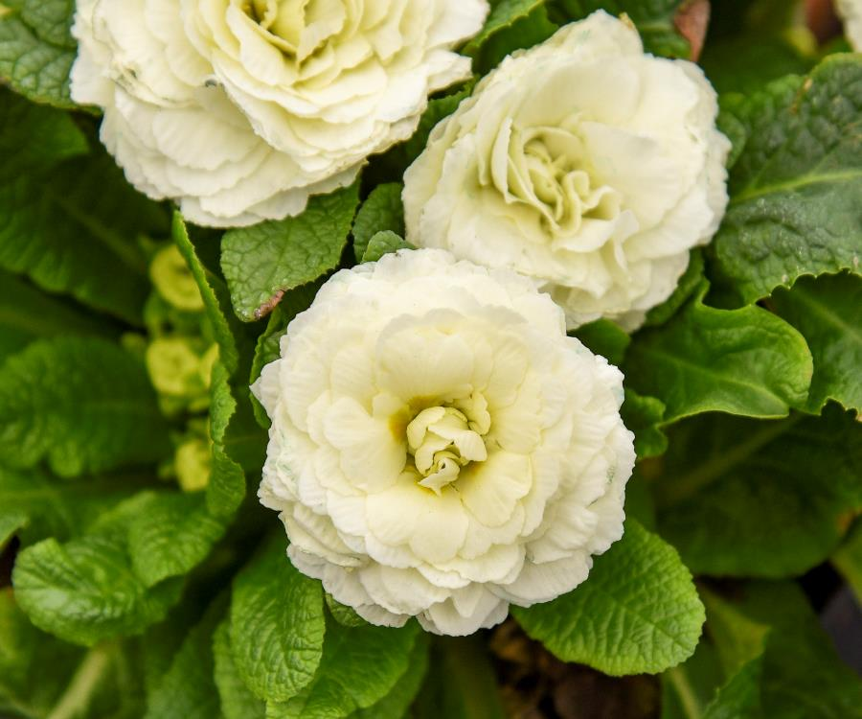
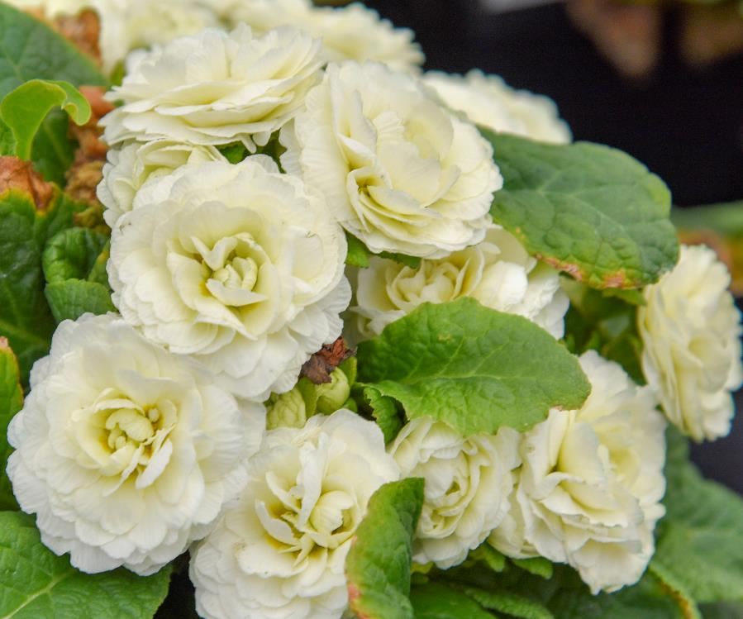
BOUQUET PERFECT™ ‘Spearmint’ Primula vulgaris (‘Kerbelmint’ PPAF)
Large white flowers have a mint-green hue

Slide 22
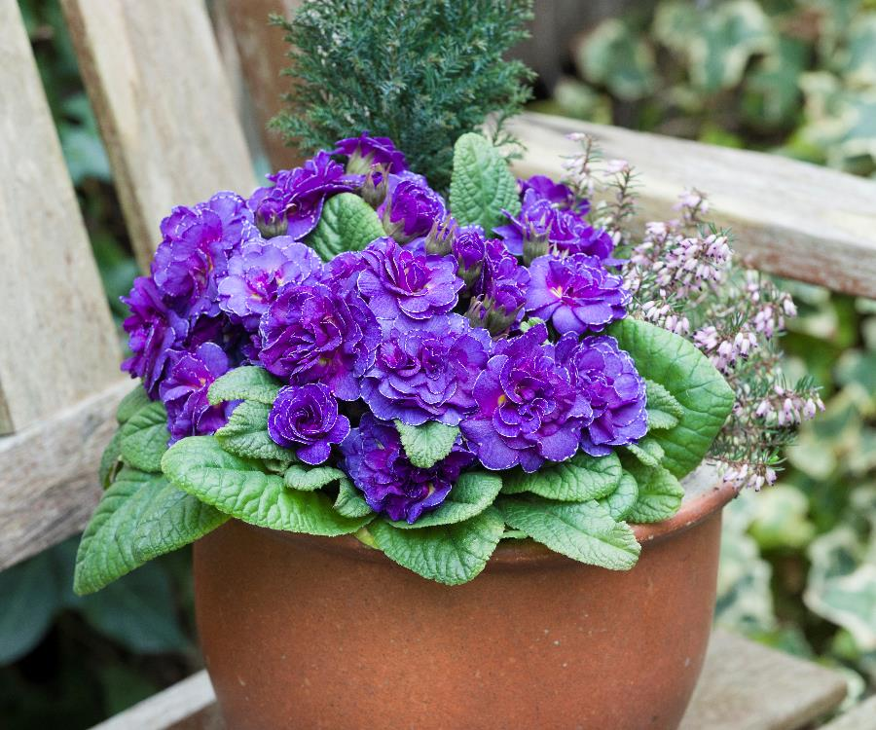
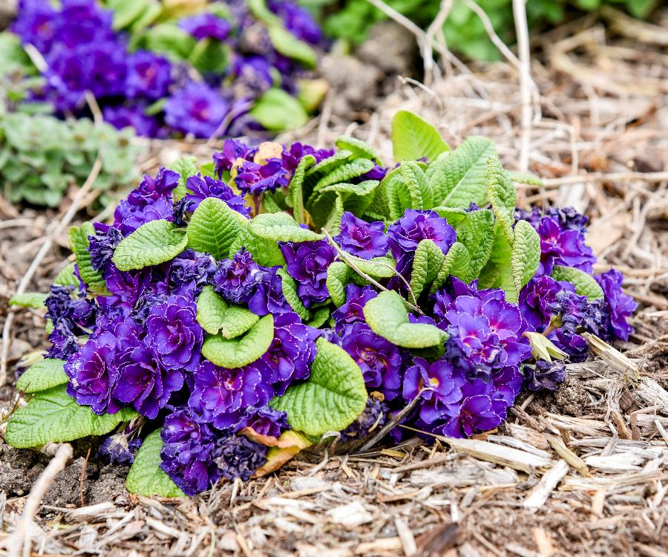
BOUQUET PERFECT™ ‘Violetta’ Primula vulgaris (‘Kerbeletta’ PPAF)
Exceptionally dark violet-blue flowers

Slide 23
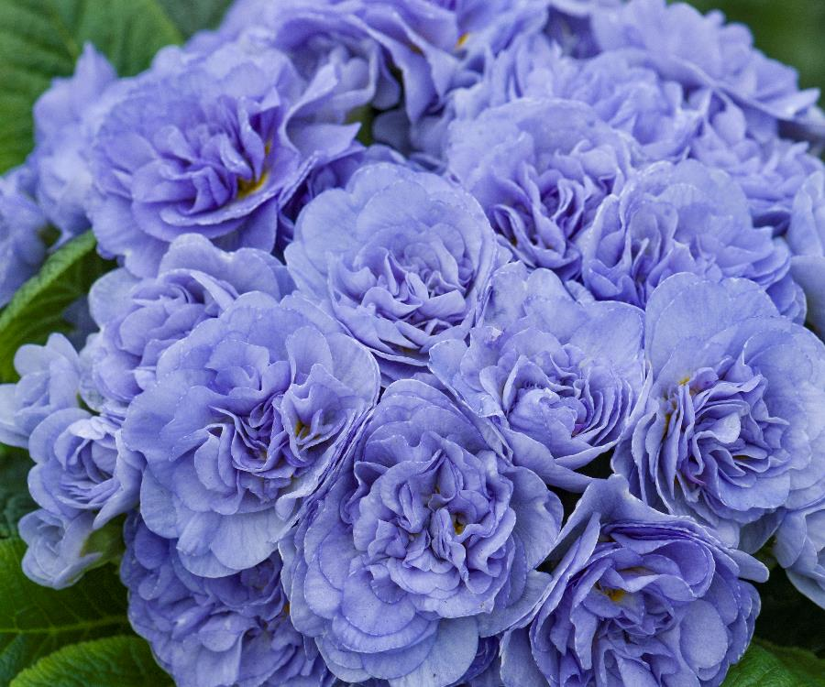
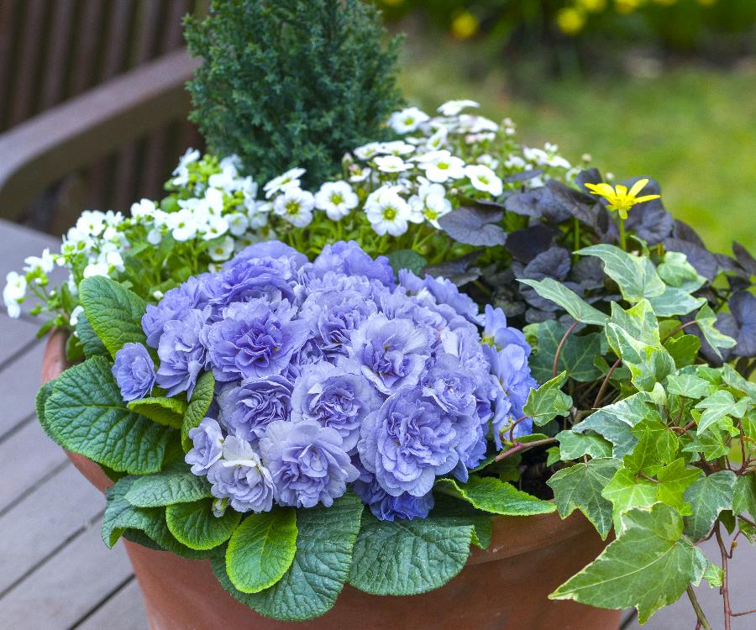
BOUQUET PERFECT™ ‘Watercolour Blue’ Primula vulgaris (‘Kerbelbluwat’ PPAF)
Sky blue flowers are darkest at their centers

Slide 24
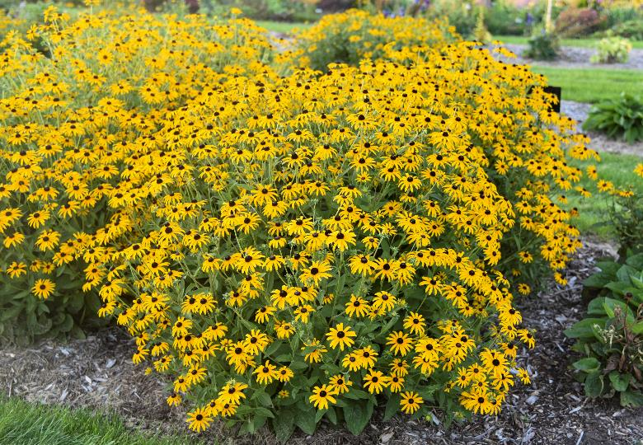
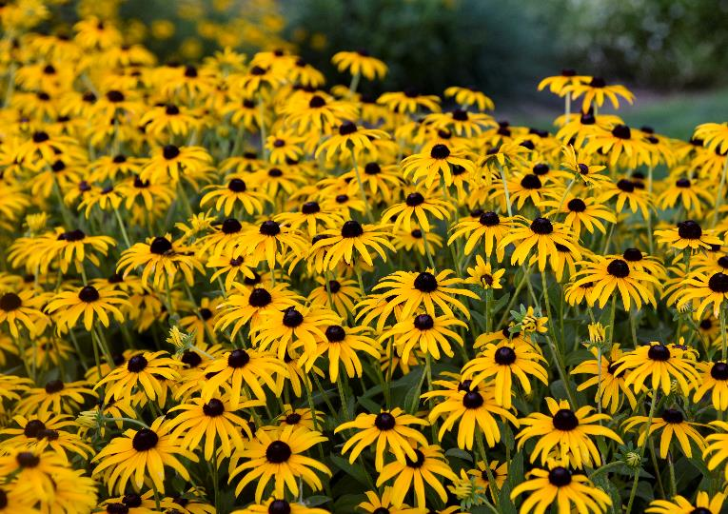
‘Treasure Trove’
Rudbeckia PPAF CPBRAF
Black-Eyed Susan | Height: 32-36” | Width: 36-42” | Zones: 4-9
Visibly clean foliage – no black spotting​
Full mounded habit​ with tall, substantial presence in the garden
Large Rudbeckia flowers – golden yellow star-shaped with black eye​

Slide 25
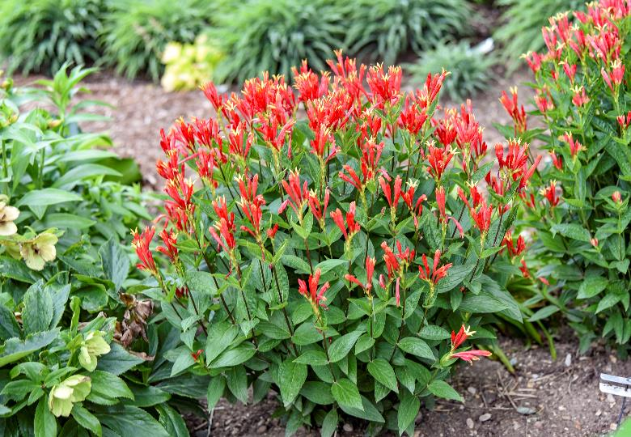
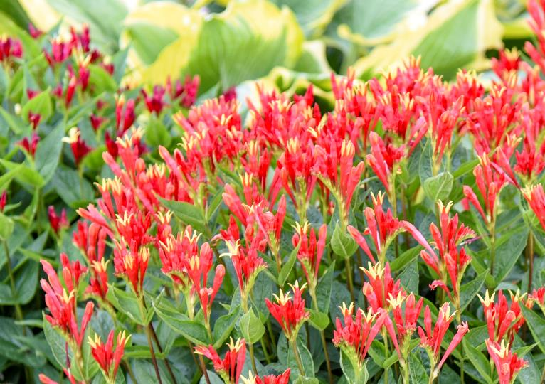
‘Orange Slices’
Spigelia marilandica PPAF CPBRAF
Spigelia | Height: 18” | Width: 16-18” | Zones: 5b-9
Tall, orange–red flowers. Very floriferous, large flowers
Flowers out of the foliage
Eastern native wildflower, great for attracting hummingbirds

Slide 26
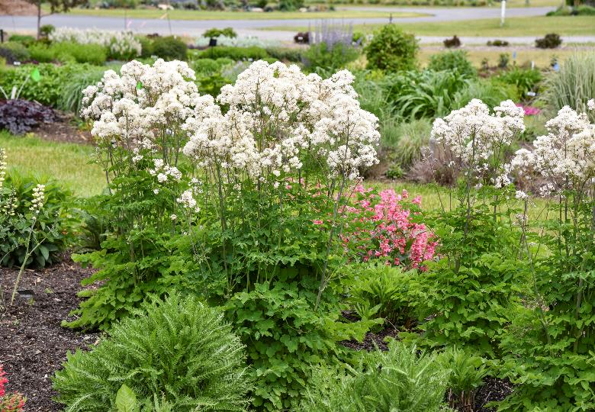

‘Cotton Ball’
Thalictrum PPAF CPBRAF
Meadow Rue | Height: 38-42” | Width: 18-24” | Zones: 5-8
White flowering companion to ‘Cotton Candy’
Sturdy, upright selection with flowers proportionate to the foliage
Dark stems make the white flowers pop

Slide 27


‘Prairie Princess’
Vernonia PPAF CPBRAF
Ironweed | Height: 26-30” | Width: 30-36” | Zones: 4-9
Compact, rounded habit – very dense compared with traditional varieties – of dark foliage and red stems. Good mildew resistance.
Mauve buds open to rosy purple
Native, late season pollinator perennial – especially butterflies

Slide 28



‘Dragon Slayer’
Yucca PPAF CPBRAF
Adam’s Needle | Height: 24” | Scape: 48” | Width: 30-36” | Zones: 5-10
Rigid lance shaped leaves are powdery blue; evergreen
Interspecific variety with wide leaves
Numerous creamy white flowers appear on proportionate scapes in early summer

Slide 29


ART & SOL™ ‘Aztec King’
Mangave PP32151
Mangave | Height: 20-24” | Width: 38-42” | Zones: 9-11
One of the largest Mangave introductions
Wide, broad silvery green leaves covered with burgundy flecks in full sun
Arching, slightly scalloped leaves create an upright, majestic appearance

Slide 30


ART & SOL™ ‘Moonglow’
Mangave PP29195
Mangave | Height: 8-10” | Width: 16-20” | Zones: 8-10
1" wide, silvery blue-green leaves with contrasting dark purple spots
Long, horizontal leaves held rigidly straight, forming a low, wide, and spiky habit
Tiny spines line the margins and terminal spines are relatively soft to the touch, much less lethal than Agave varieties

Slide 31


ART & SOL™ ‘Purple People Eater’
Mangave PP29949
Mangave | Height: 12-16” | Width: 16-24” | Zones: 9-11
Thick, sturdy blue-green leaves with reddish-purple spotting, appearing purple from a distance.
Best coloration in full sun; less intense exposure results in greener leaves
Margins fold upward to display yellow, orange, and cinnamon brown spines, with a cinnamon terminal spine at each leaf tip

Slide 32


ART & SOL™ ‘Silver Fox’
Mangave PP29642
Mangave | Height: 8-10” | Width: 16-18” | Zones: 9-11
Appears silver at first glance, but is actually light green with a thick waxy coating
Features thick, arching leaves with defined marginal teeth

Slide 33

Questions?

